Slide 1
“Banking Management System”

Slide 2
Sr. no | Title
1. | Project Scope and Description
2. | Tools and Technologies
3. | Diagrams
4. | Screen Shots of the project
5. | Test Report
6. | Conclusion
7. | Bibliography
INDEX

Slide 3
Project Scope and Description
Description
The Banking Management System is a comprehensive software solution developed in Java using JSP (Java Server Pages), Servlets, and other technologies. The primary objective of this system is to provide an efficient and secure platform for managing various banking operations and services. It facilitates seamless interactions between customers, employees, and administrators, ensuring a

Slide 4
Scope
The scope of the Banking Management System encompasses the following key functionalities:
Customer Registration and Authentication
Account Management
Fund Transfer
Credit Management
User Management
Administrative Controls

Slide 5
Technology Stack:
Front-End: JSP (Java Server Pages), HTML, CSS, JavaScript
Back-End: Java, Servlets, JDBC (Java Database Connectivity)
Database: MySQL or any other suitable RDBMS (Relational Database Management System)
Application Server: Apache Tomcat or any compatible server
Project Deliverables:
Complete source code of the Banking Management System
User documentation with instructions for installation and usage
Test cases and test results to ensure system functionality and reliability.
Any additional tools or utilities required for the smooth operation of the system.

Slide 6
Name | Data_Type | Field Length | Constraints
acc_no | Int | 7 | Primary Key
uname | Varchar | 45 | NOT NULL
acc_type | Varchar | 45 | NOT NULL
details | Varchar | 45 | NOT NULL
ACCOUNT DETAIL

Slide 7
FUND TRANSFER DETAILS
Name | Data_Type | Field Length | Constraints
id | Int | 7 | Primary Key
uname | Varchar | 45 | NOT NULL
acc_no | Varchar | 45 | NOT NULL
dest_acc | Varchar | 45 | NOT NULL
amt | Int | 10 | NOT NULL
details | Varchar | 45 | NOT NULL
time1 | Timestamp | 45 | NOT NULL

Slide 8
TRANSACTION DETAILS
Name | Data_Type | Field Length | Constraints
uname | Varchar | 45 | NOT NULL
acc_no | Int | 7 | Primary Key
operation | Varchar | 45 | NOT NULL
amt | Int | 10 | NOT NULL
balance | Int | 20 | NOT NULL
time1 | Timestamp |  | NOT NULL
isnew | Varchar | 3 | NOT NULL

Slide 9
USER DETAILS
Name | Data_Type | Field Length | Constraints
id | Int | 7 | Primary Key
uname | Varchar | 15 | NOT NULL
upass | Varchar | 8 | NOT NULL
sec_question | Varchar | 45 | NOT NULL
answer | Varchar | 45 | NOT NULL
address | Varchar | 50 | NOT NULL
email | Email | 45 | NOT NULL
mobile | Long | 10 | NOT NULL

Slide 10
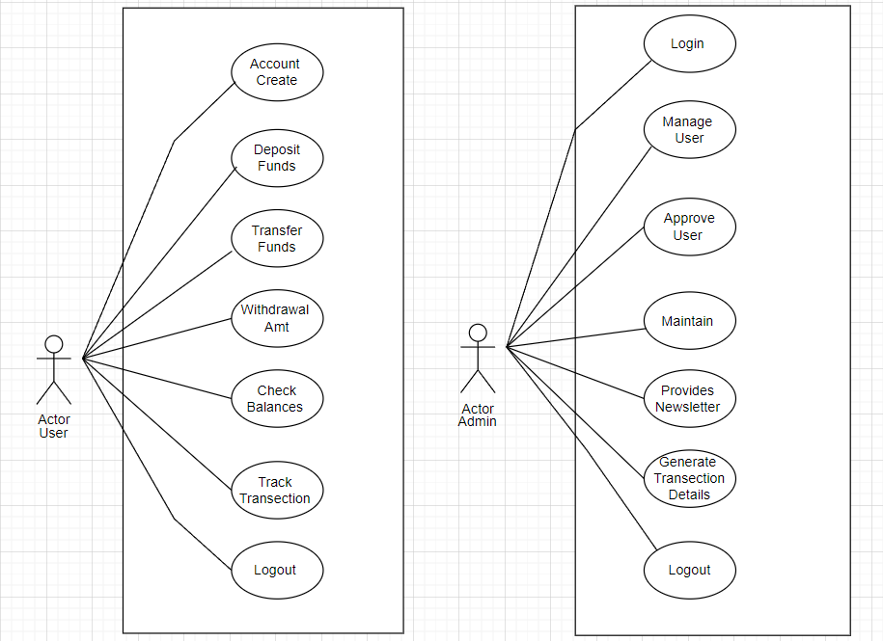
USE CASE DIAGRAM

Slide 11
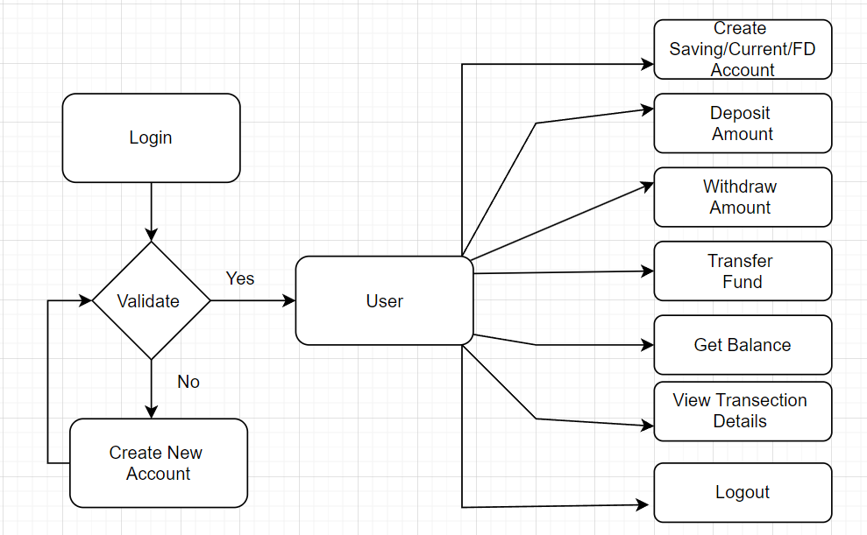
SYSTEM FLOW DIAGRAM

Slide 12
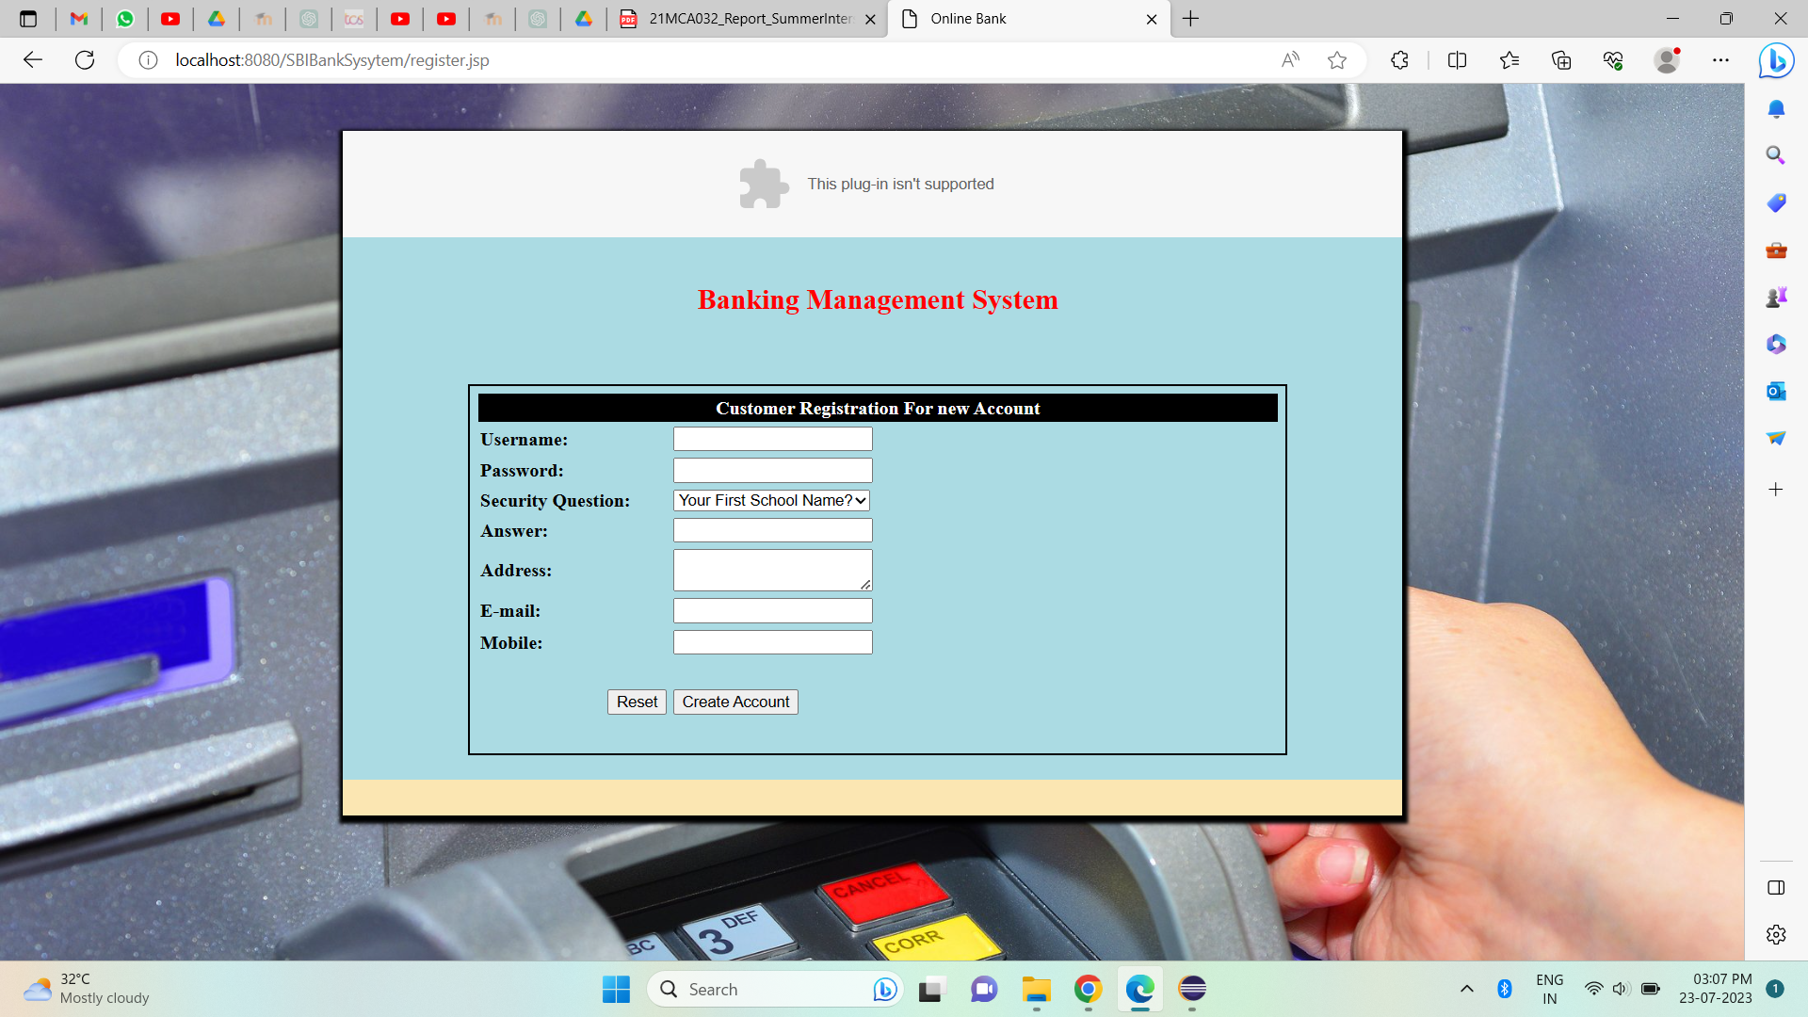
Create New Account

Slide 13
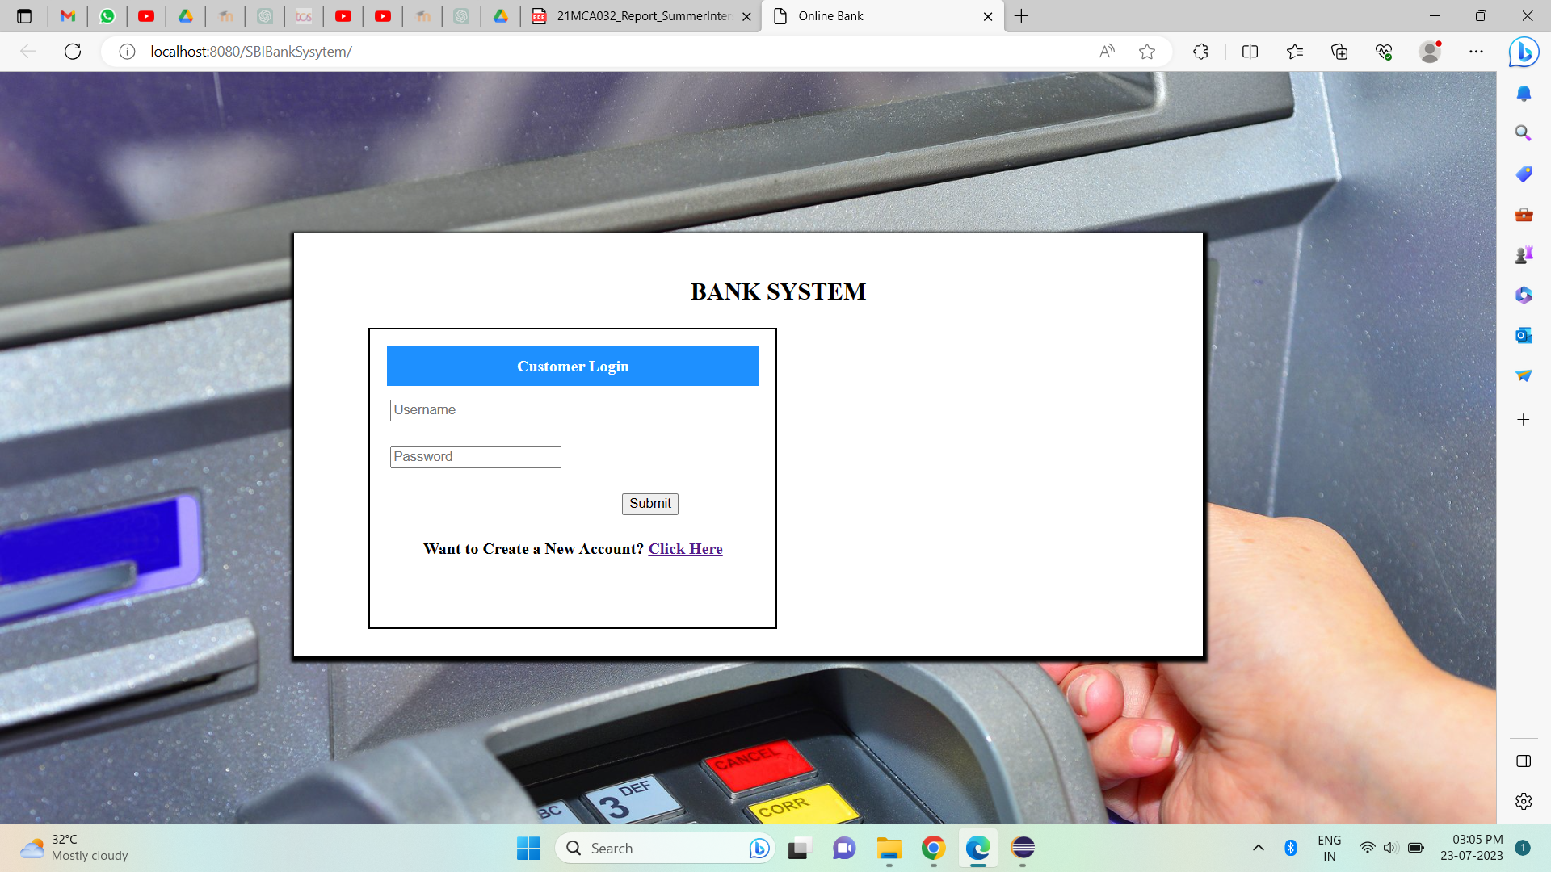
Login Page:

Slide 14
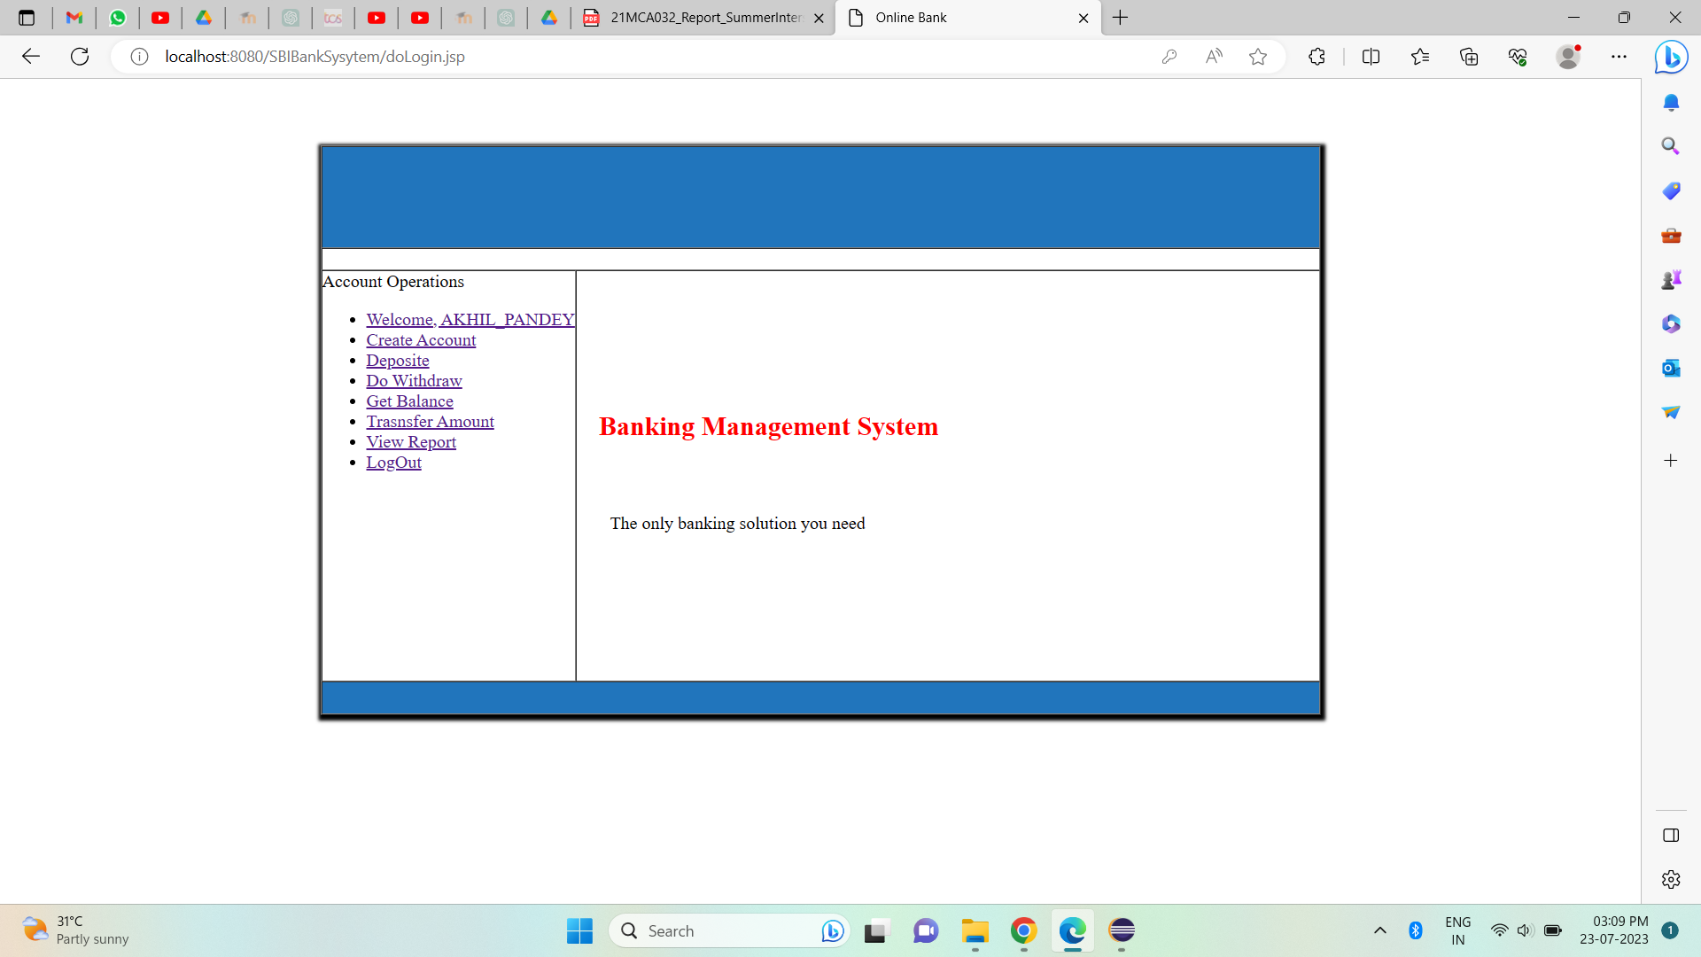
Homepage:

Slide 15
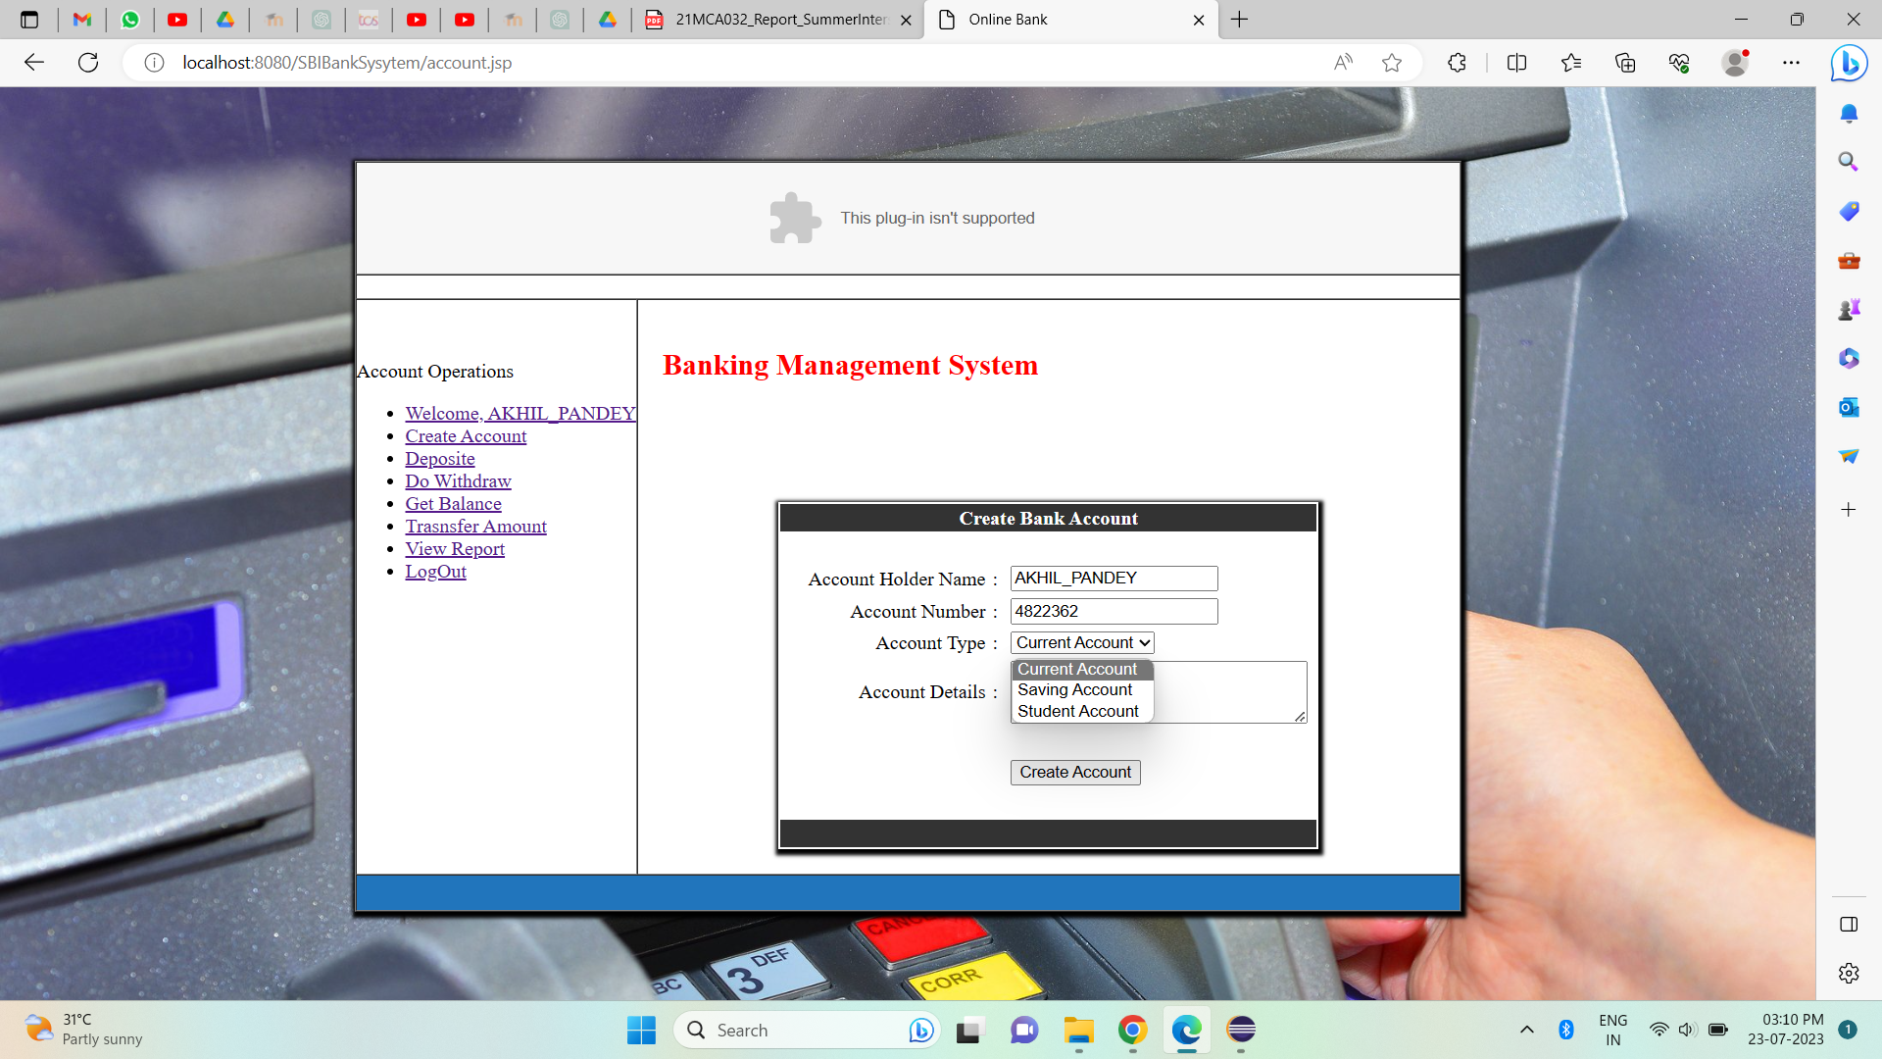
CREATE ACCOUNT

Slide 16
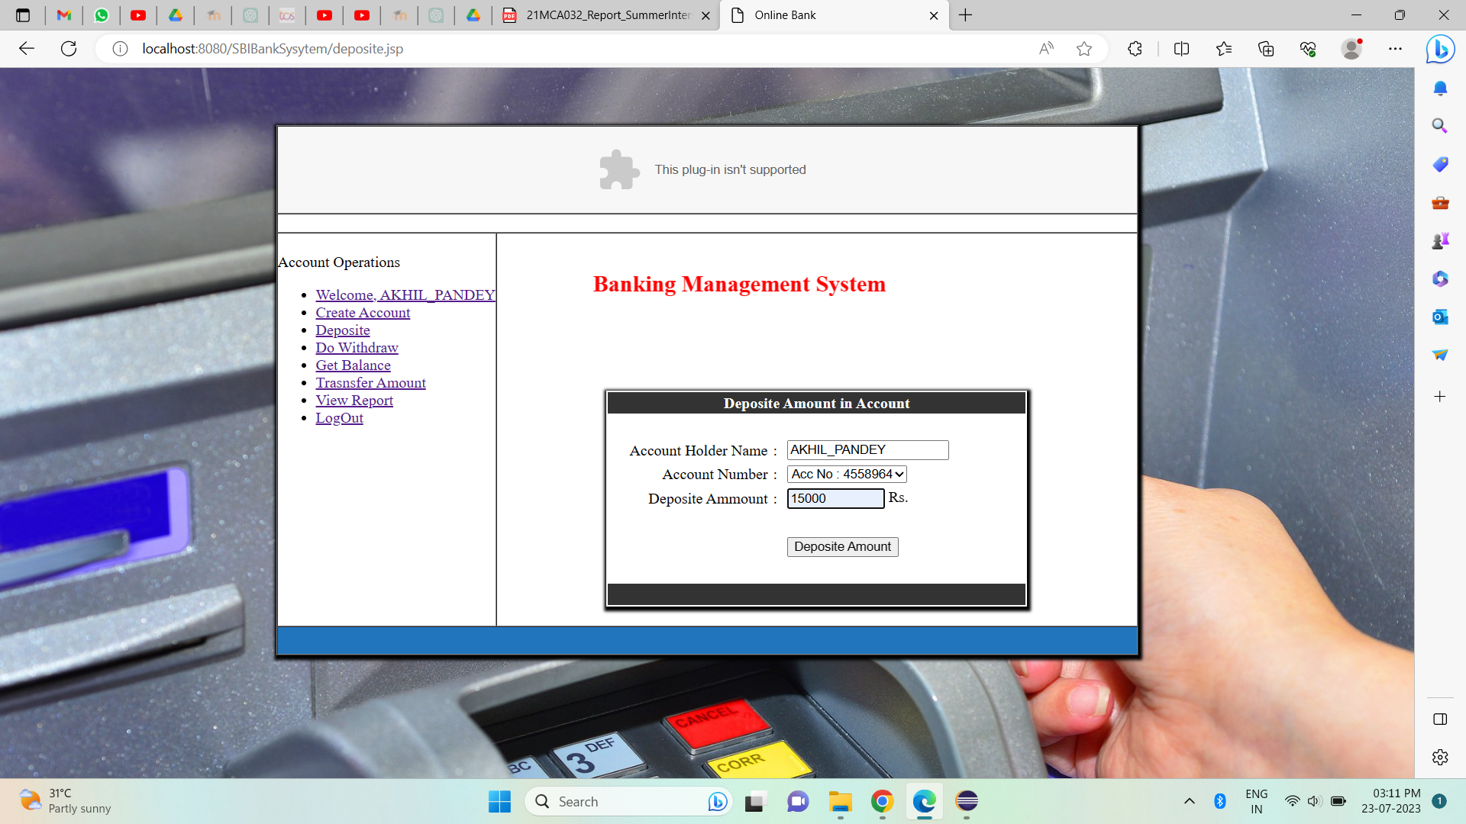
DEPOSITE AMMOUNT

Slide 17
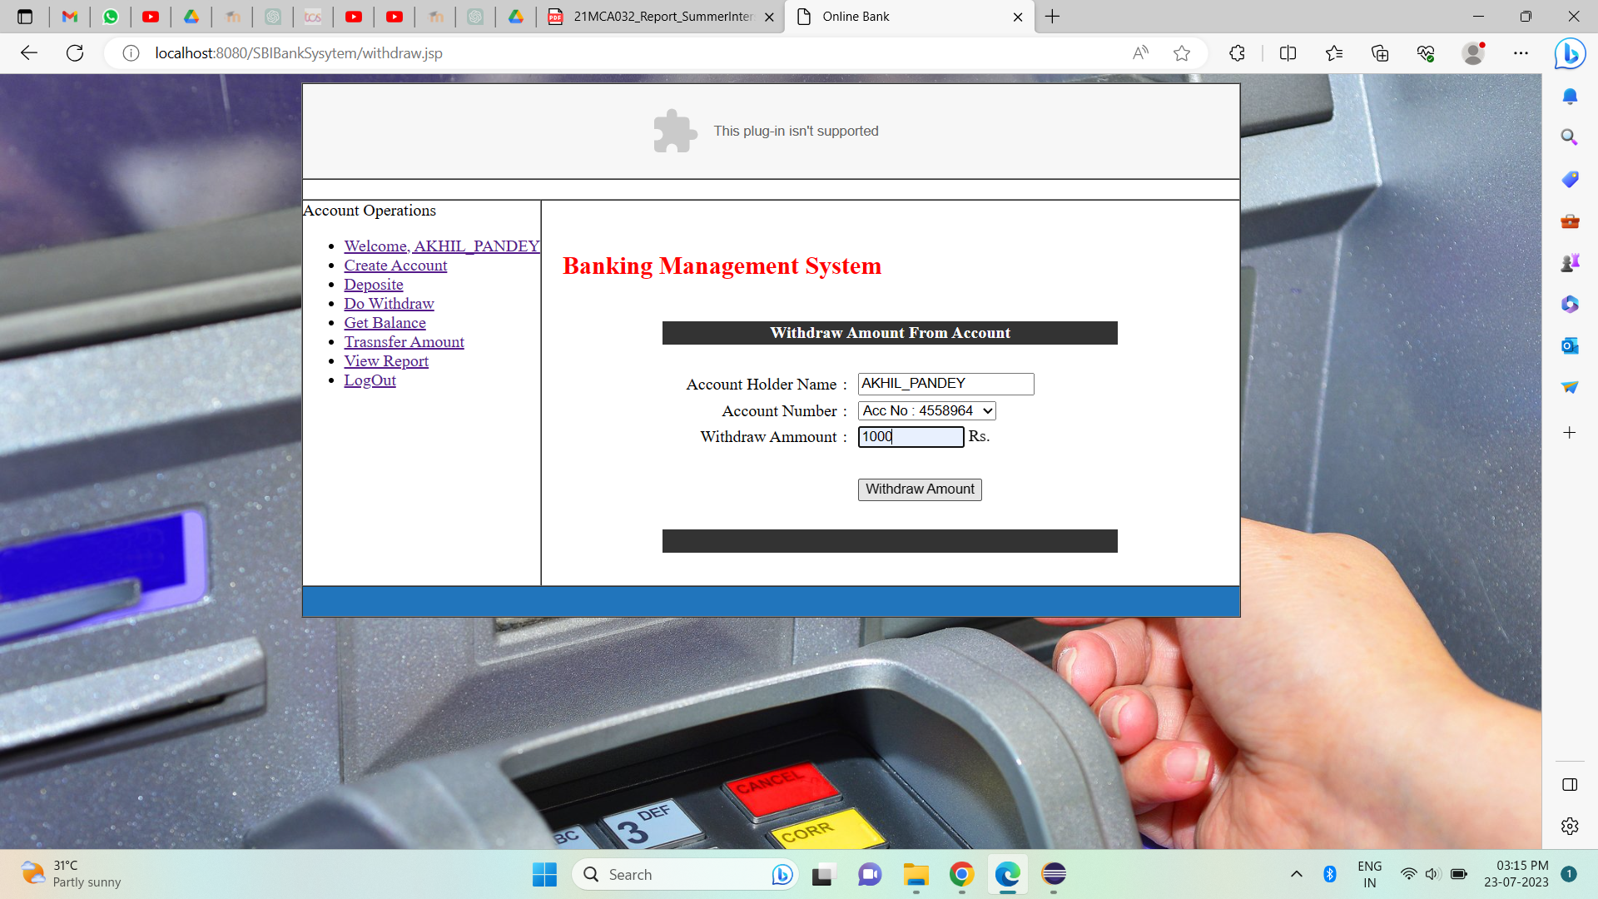
Withdraw Amount

Slide 18
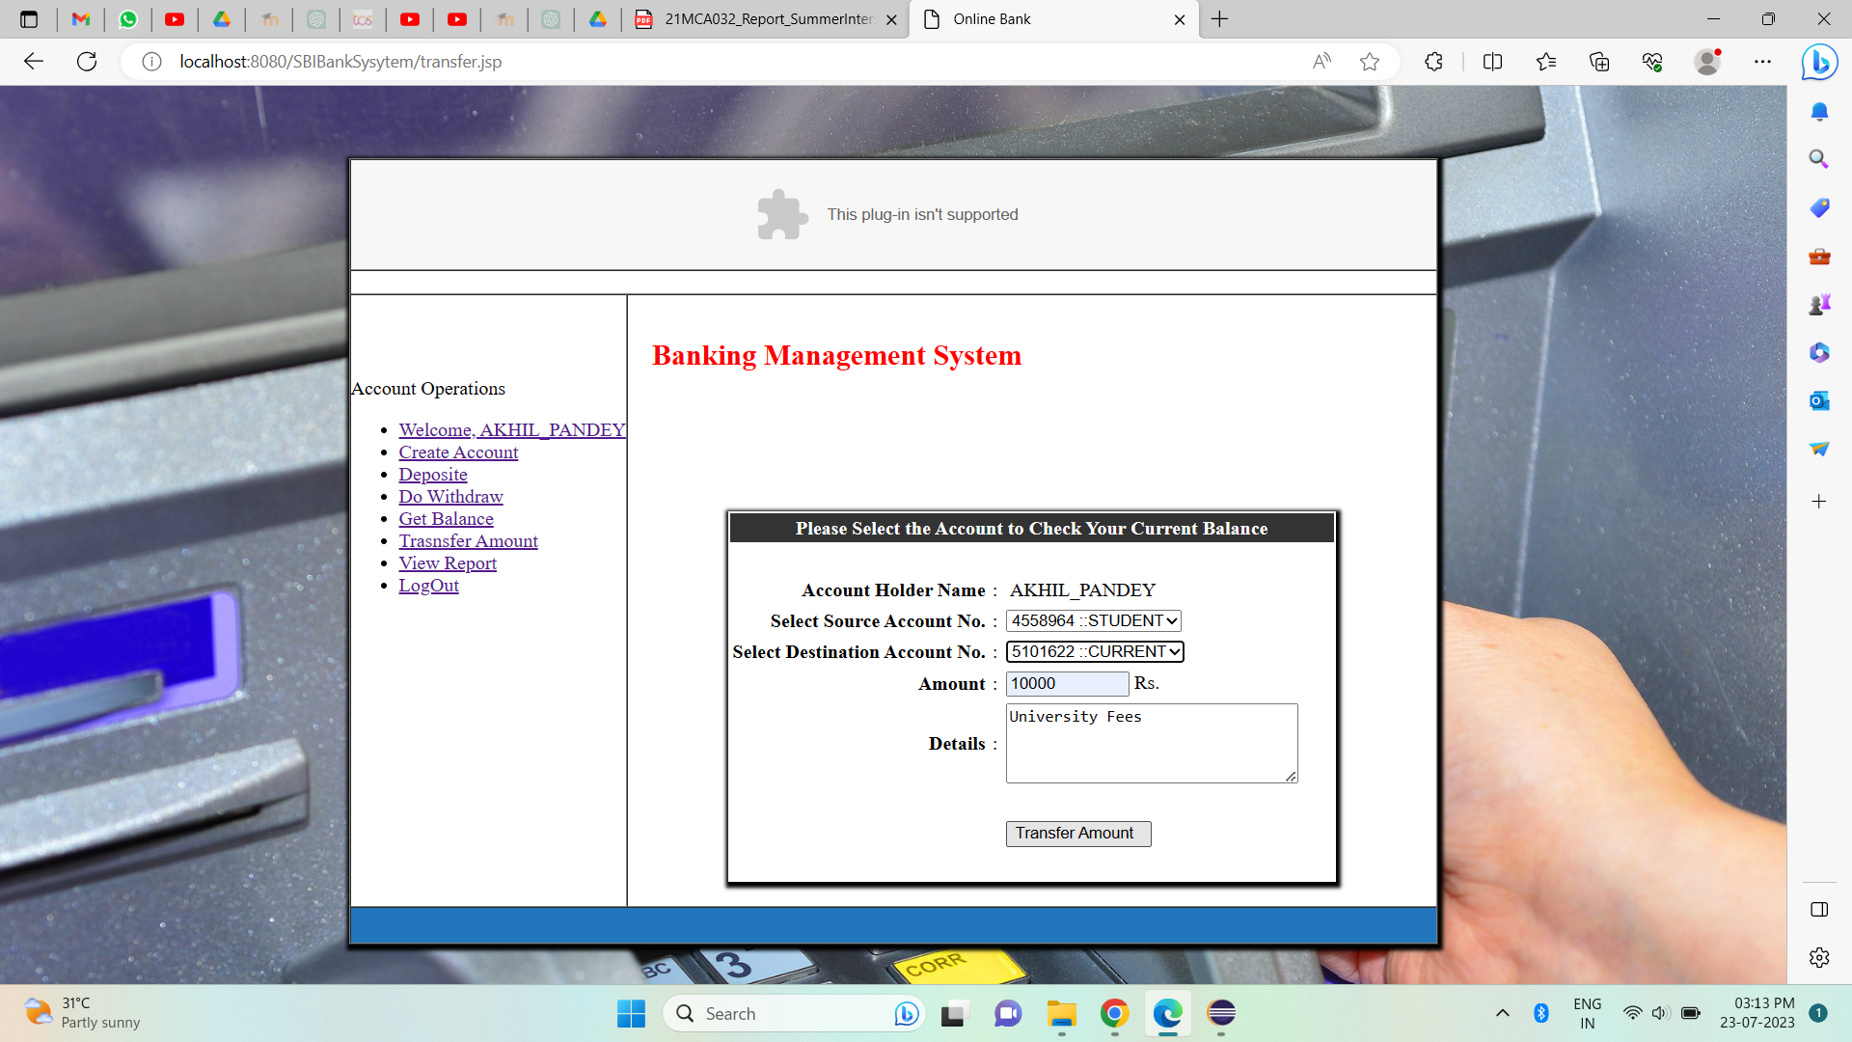
Transfer Ammount

Slide 19
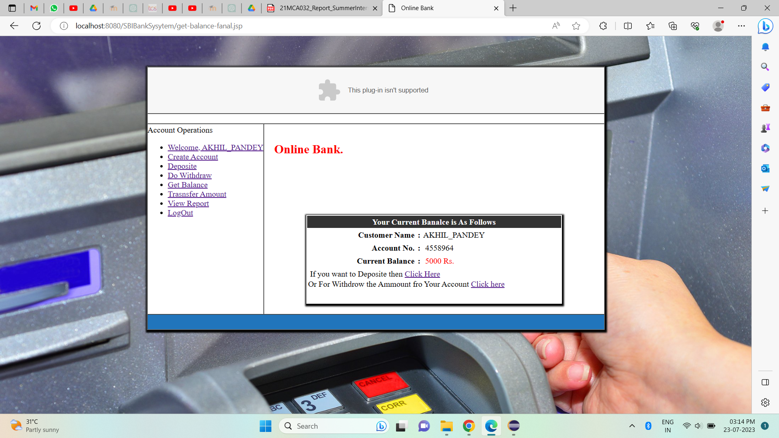
CHECK BALANCES

Slide 20
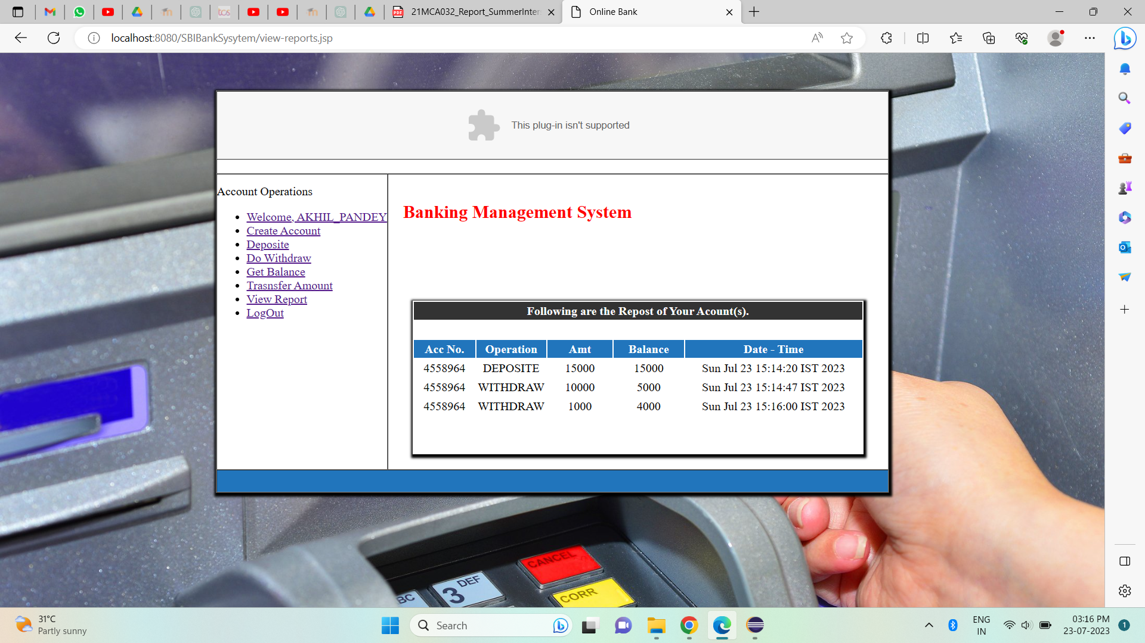
VIEW TRANSCRIPT

Slide 21
Test Case 1: Customer Registration and Authentication
Test Case ID: TC001
Test Case Description: Verify that a new customer can register successfully and log in securely.
Test Steps:
Click on the "Register" button on the login page.
Fill in the required fields with valid customer information (e.g., name, email, address, etc.).
Set a secure password that meets the system's password policy.
Click on the "Register" button to create the account.
Verify that the customer is redirected to the login page after successful registration.
Enter the registered username and password.
Click on the "Login" button.
Verify that the customer is successfully logged into the system and is redirected to the dashboard.
Expected Result: The new customer should be able to register successfully and log in without any errors.
Test Case Status: Passed

Slide 22
Test Case 2: Account Management
Test Case ID: TC002
Test Case Description: Verify that customers can open different types of accounts and view their account details.
Test Steps:
Log in to the system using valid customer credentials.
Click on the "Open Account" option in the dashboard.
Select "Savings Account" as the account type.
Fill in the necessary details and click on the "Submit" button.
Verify that the savings account is created successfully.
Repeat steps 2 to 5 for "Current Account" and "Fixed Deposit Account."
Go to the "My Accounts" section and click on the "View Details" option for each account.
Verify that the account details, including account balance, transaction history, and account type, are displayed correctly.
Expected Result: Customers should be able to open different types of accounts and view their account details without any issues.
Test Case Status: Passed

Slide 23
Test Case 3: Fund Transfer
Test Case ID: TC003
Test Case Description: Verify that customers can transfer funds between their accounts and to other registered users.
Test Steps:
Log in to the system using valid customer credentials.
Click on the "Transfer Funds" option in the dashboard.
Select "Transfer to Own Account" and choose a source and destination account.
Enter the transfer amount and click on the "Transfer" button.
Verify that the funds are transferred successfully, and the account balance is updated accordingly.
Repeat steps 2 to 4 for "Transfer to Other User" using a registered user's account.
Verify that the transfer is successful and reflects in the recipient's account.
Expected Result: Customers should be able to transfer funds between their accounts and to other registered users without any errors.
Test Case Status: Passed

Slide 24
Test Case 4: Credit Management
Test Case ID: TC004
Test Case Description: Verify that customers can apply for loans and check their credit eligibility.
Test Steps:
Log in to the system using valid customer credentials.
Click on the "Apply for Loan" option in the dashboard.
Choose a loan type (e.g., Personal Loan, Home Loan) and enter the loan amount.
Click on the "Submit" button to apply for the loan.
Verify that the loan application is processed and forwarded for approval.
Go to the "Check Credit Eligibility" option in the dashboard.
Verify that the system displays the customer's credit score and eligibility status.
Expected Result: Customers should be able to apply for loans and check their credit eligibility without any issues.
Test Case Status: Passed

Slide 25
Test Case 5: User Management
Test Case ID: TC005
Test Case Description: Verify that bank users can access the system with their credentials and perform authorized tasks.
Test Steps:
Log in to the system using valid employee credentials.
Verify that the employee is redirected to the employee dashboard.
Check if the employee can view customer information and process transactions.
Log in to the system using valid administrator credentials.
Verify that the administrator is redirected to the admin dashboard.
Check if the administrator can manage employee accounts and oversee system security.
Expected Result: Bank users should be able to log in and perform authorized tasks based on their roles (employee or administrator).
Test Case Status: Passed

Slide 26
Test Case 6: Administrative Controls
Test Case ID: TC006
Test Case Description: Verify that administrators can perform advanced functionalities and manage system settings.
Test Steps:
Log in to the system using valid administrator credentials.
Go to the "Employee Management" section in the admin dashboard.
Add a new employee account with necessary details.
Verify that the new employee account is created successfully.
Go to the "Services Management" section in the admin dashboard.
Add a new banking service to the system.
Verify that the new service is added to the available services.
Expected Result: Administrators should be able to manage employee accounts, add/remove services, and perform other administrative tasks without any issues.
Test Case Status: Passed

Slide 27
Conclusion:
The Banking Management System developed in Java using JSP and other related technologies aims to streamline banking operations and enhance customer experience. It provides a secure, efficient, and user-friendly platform for customers, employees, and administrators to carry out their tasks effectively. By leveraging the power of technology, the system contributes to the growth and success of the bank by ensuring optimal management of financial services.

Slide 28
Bibliography
https://www.javatpoint.com/servlet-api
https://www.javatpoint.com/requestdispatcher-in-servlet
https://stackoverflow.com/
https://javapipe.com/blog/tomcat-application-server/
https://www.coursera.org/learn

